Slide 1
Numpy Nuances and Internals

Slide 2
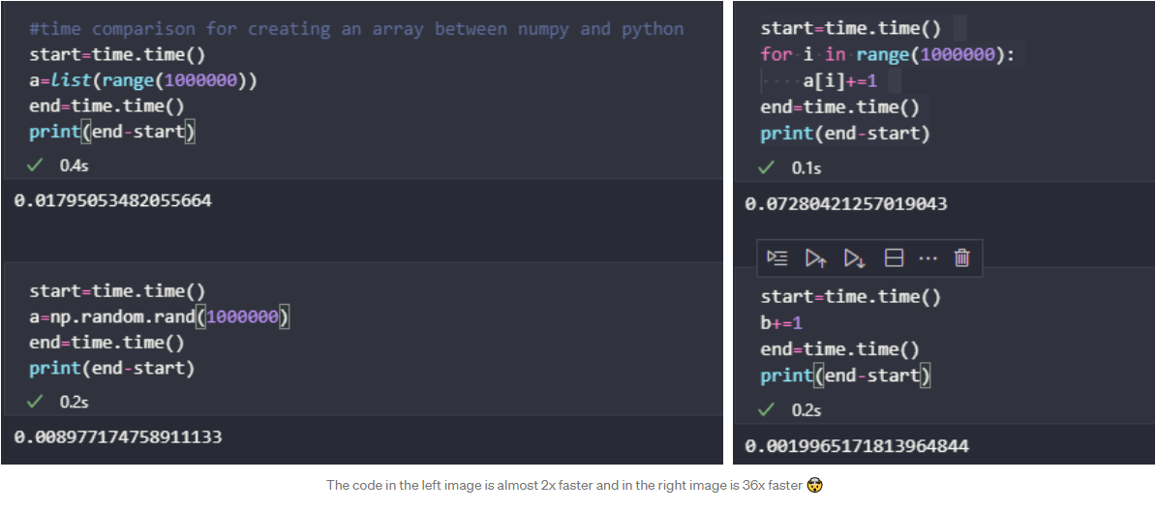
What is Numpy? And why you should use it?
Numpy is the fundamental package for scientific computing in python.
It is used to speed up vector operations and function calls by as much as 100 times as compared to vanilla python code

Slide 3
Why is Numpy so fast ⚡?
Language and Compiler.
Vectorization.
Specially Optimized code for different operations.

Slide 4
Language and Compiler
The reason numpy is fast is because a lot of its operations are written in C and fortran.
C is a statically typed language which has faster function calls and loops as compared to dynamically typed languages like python.
There are certain packages like cython that allow you to execute your C code as python.
Numpy can be even further sped up by using Numba which is an open source JIT compiler.
Notes:
The Just-In-Time (JIT) compiler is a component of the runtime environment that improves the performance of Java™ applications by compiling bytecodes to native machine code at run time.

Slide 5
Vectorization
Vectorization is the main reason numpy is as fast as it is.
Vectorization is the process of carrying out multiple operations at once to increase the computational speed.
It is related to the concept of parallelism and not concurrency.
Locality of reference also plays an integral part in the computation speed of numpy.
Vectorization uses SIMD (Single Instruction Multiple Data) instructions in the processor to make the code faster.
Notes:
Locality of reference is the reason its written in c cause the data blocks are close by in memory.

Slide 6
Let’s take a look at an example
Suppose your computer has an AVX512 instruction set, that means you can work on 16 integers at the same time. So if you have a vector of 16 integers, you can either load them into the general register one by one and execute the instruction.
Or
You could load all 16 values on the SIMD register at the same time and execute the instruction only once. This will decrease the computation time from “N” to “N/16”.

Slide 7
Individual Optimizations
There are a lot of individual optimizations in numpy, let’s consider the optimizations specifically for the arrays.
But first let’s take a look at what makes a numpy array different from a python list.
So a python list can be of varying size and can have elements of varying data types. This results in a lot of overhead.
Python lists have 4 main components that influence their size:
Size
Object
Object type
Reference Count
Notes:
Size: The size of the object. (In this case 4 bytes)
Object Value: The bits of the object.
Object Type: The type of the object.
Reference Count: The amount of time this object has been called. Used for garbage collection and memory management.

Slide 8
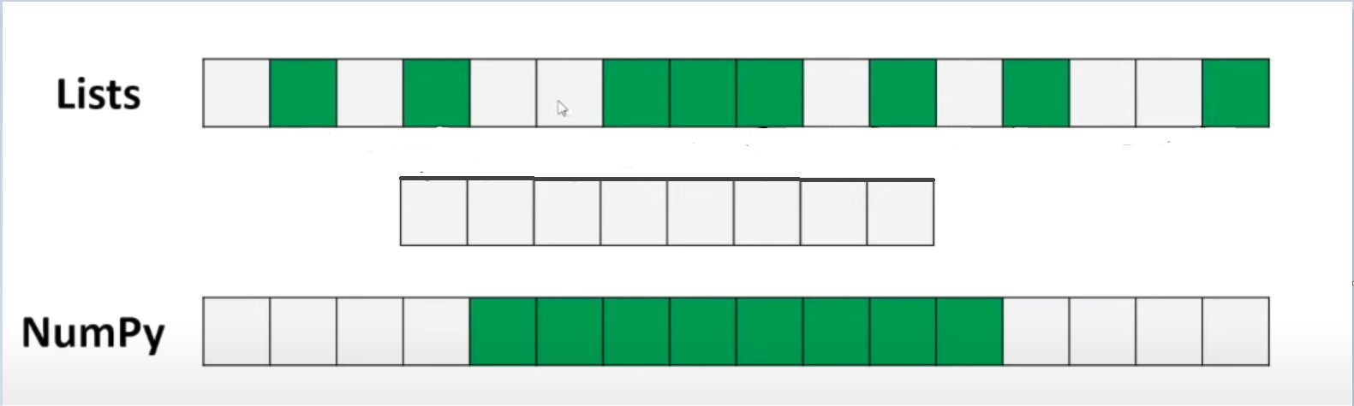
Now all these are roughly 4 bytes each, so 4*4 that’s 16 bytes of memory. They can also be 8 bytes, so it can even go up to 32 bytes.
A numpy array which contains int32 objects is only 4 bytes in size.
Numpy arrays also utilize contiguous memory unlike python lists. And since the data points are in the same sets of memory location, we can apply vectorization.

Slide 9
Questions ?

